Slide 1
LTEP Application Seminar
October 8, 2016

Slide 2
The mail and link – This is the first thing that you receives that starts the process
Congratulations on your selection as a Rotary exchange student by the Rotarians of District 5100, and welcome to the beginning of a unique, life-changing journey.
Please register with us by using the following link, which has been created uniquely for you:
The link has ben removed from this slide but in should be in the email sent to you.
This registration process will provide District 5100 with the necessary information to contact you and your parents. You can start and stop while completing this application. You will need to know you log in and password to come back to the application after you start. Do not start a new application after you have started the process. I hope you can make it to the application seminar on Saturday, October 8, 2016.
I know you are excited to learn which country will host you next year, and anxious to get started on the process. We share your excitement, and look forward to meeting you soon.
It is very important that you continue to check your e-mail regularly, as vital messages and notifications will be sent to the e-mail address we have on file for you. If you change your e-mail address, let us know right away. And if you do not already have your own e-mail address (for example, if this message is going to a parent's e-mail), then it is required that you obtain one of your own immediately. Look into Google G-mail, Yahoo, or Hotmail for free e-mail accounts that will be accessible anywhere in the world.
If you have any questions, please contact your sponsor District Outbound Coordinator, Steve Schwab (steve@sunsetgarbage.com).
Again, congratulations and welcome to Rotary Youth Exchange!

Slide 3
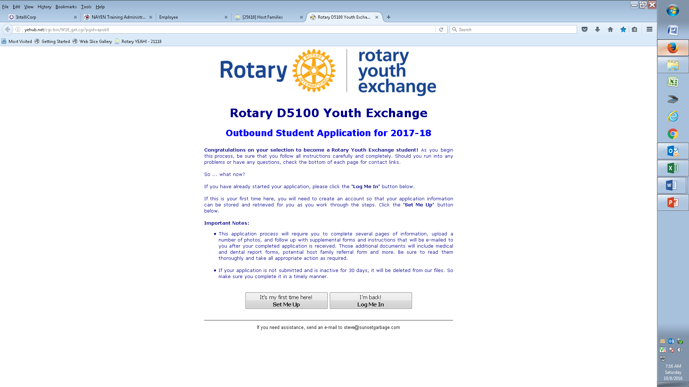
Application Link Page – This is the page that will appear when you click or enter the application link in the email you were sent. Click on the “Ste Me Up” tab.

Slide 4
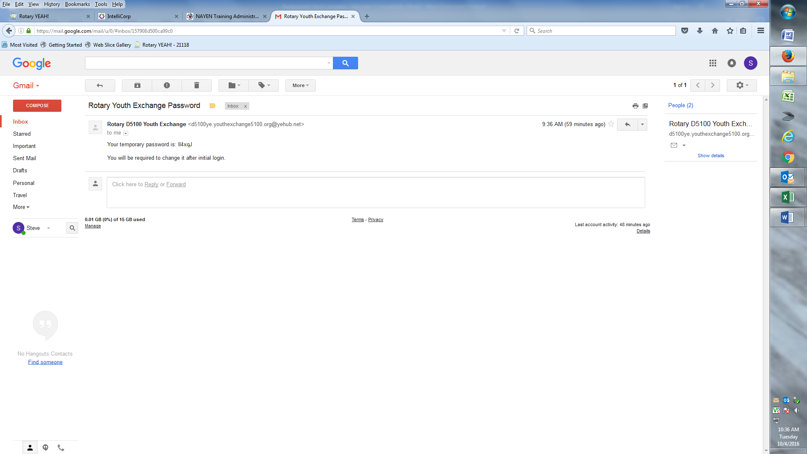
The email you receive when you sign into the YEAH (Youth Exchange Administrative Hub) system. This email has your temporary password to enter into the application process. Everyone’s is different.

Slide 5
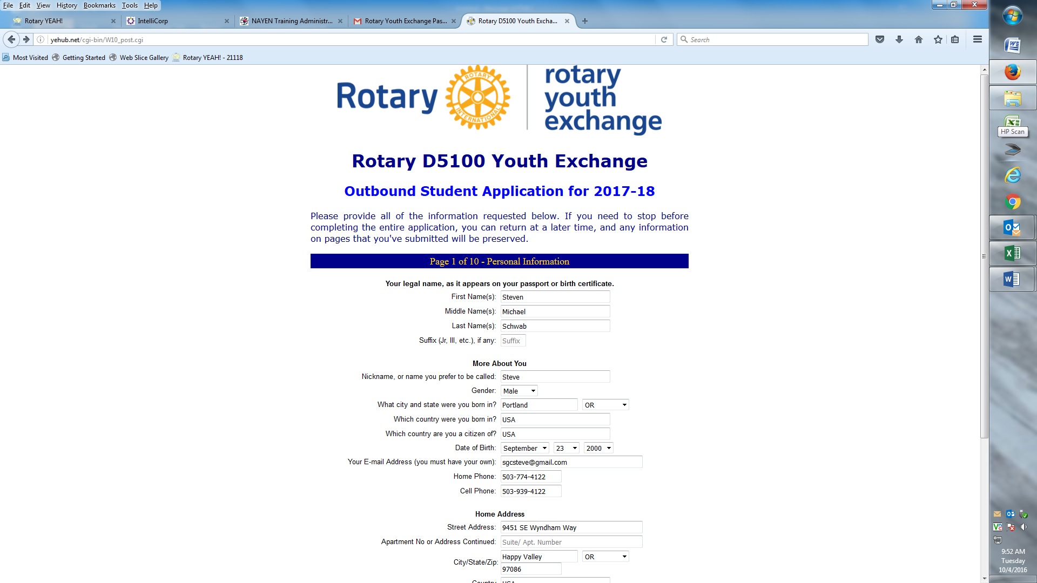
Application – Page 1 - Top

Slide 6
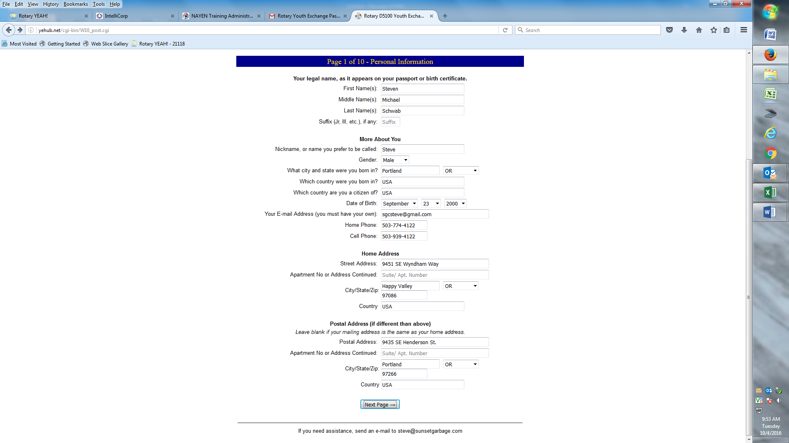
Page 1 - Bottom

Slide 7
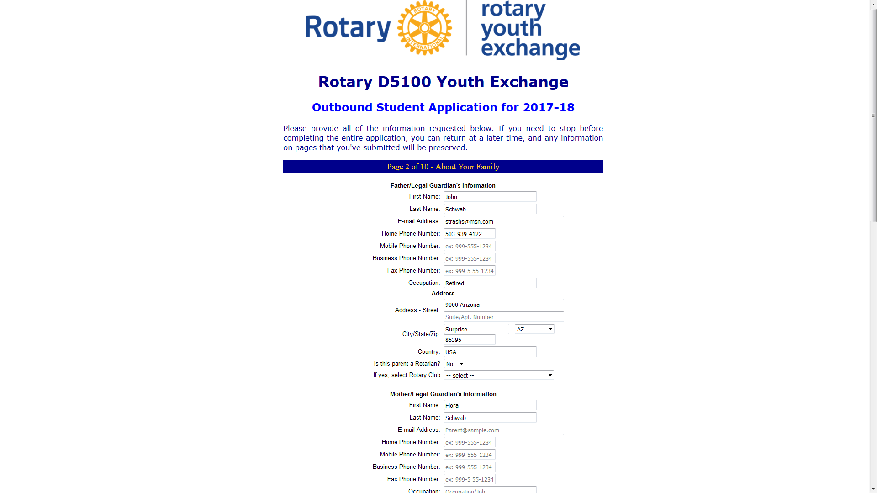
Page 2 - Top

Slide 8
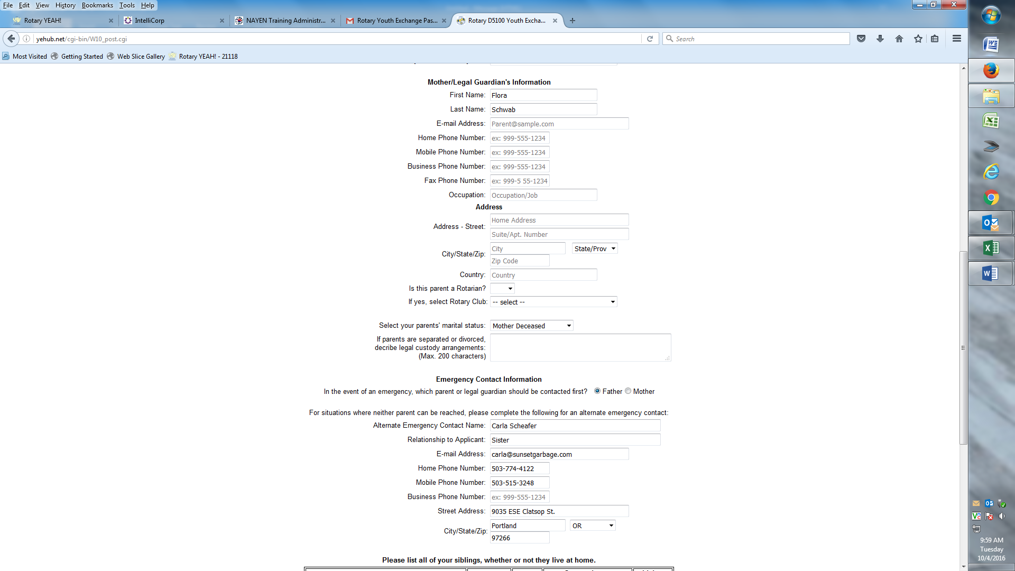
Page 2 - Middle

Slide 9
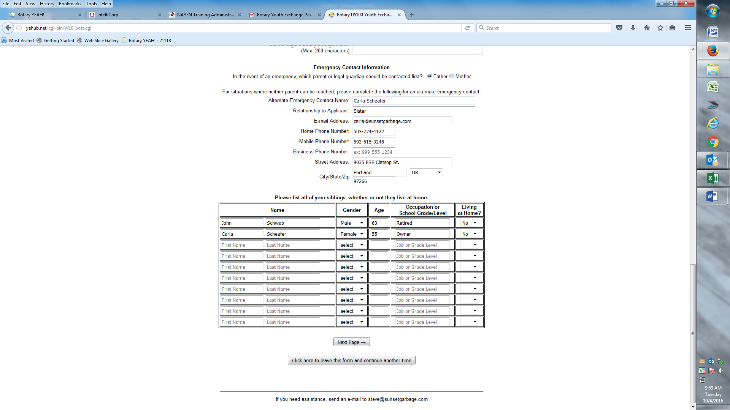
Page 2 - Bottom

Slide 10
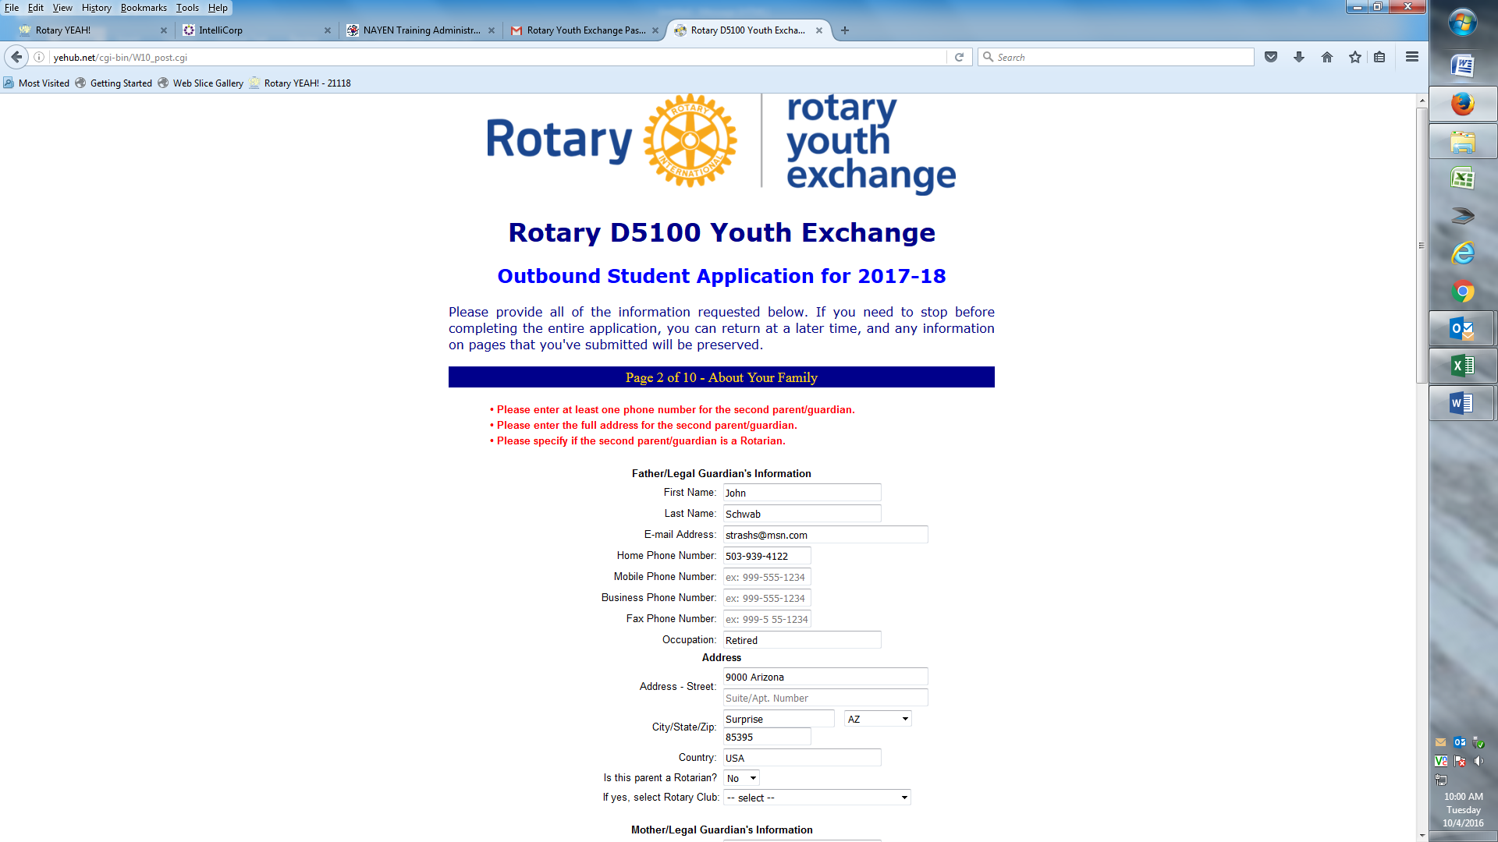
Page 2 – Error Message

Slide 11
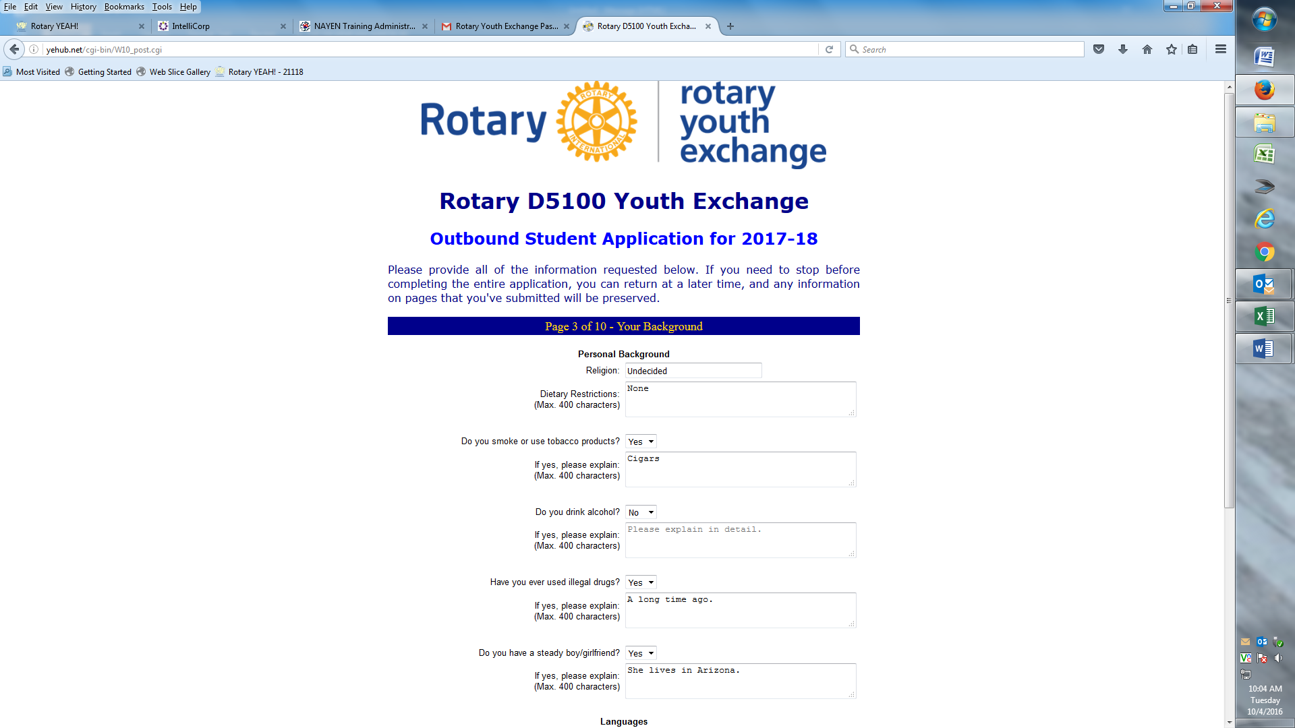
Page 3 - Top

Slide 12
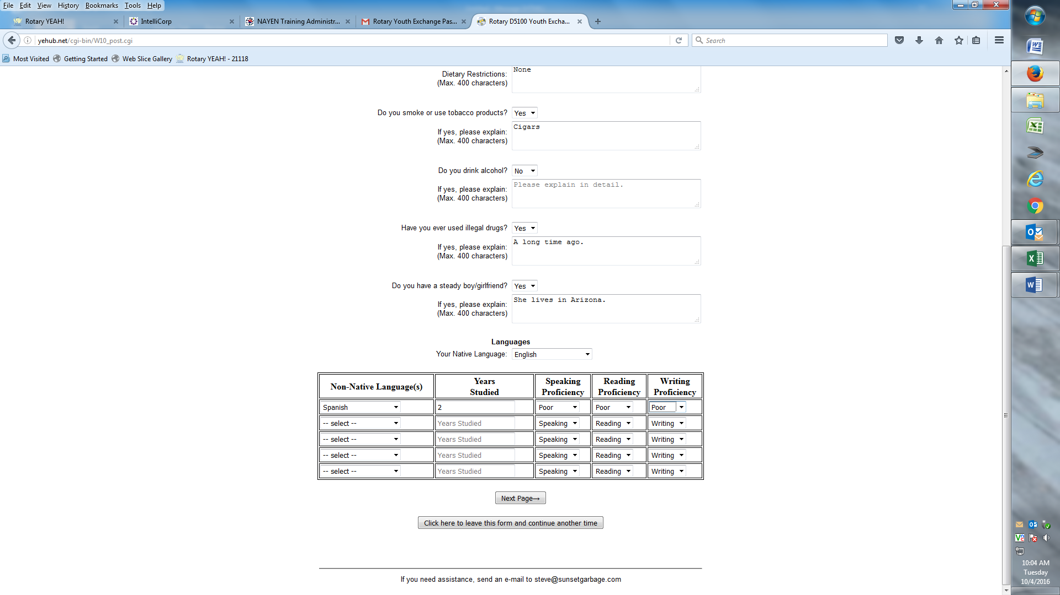
Page 3 - Bottom

Slide 13
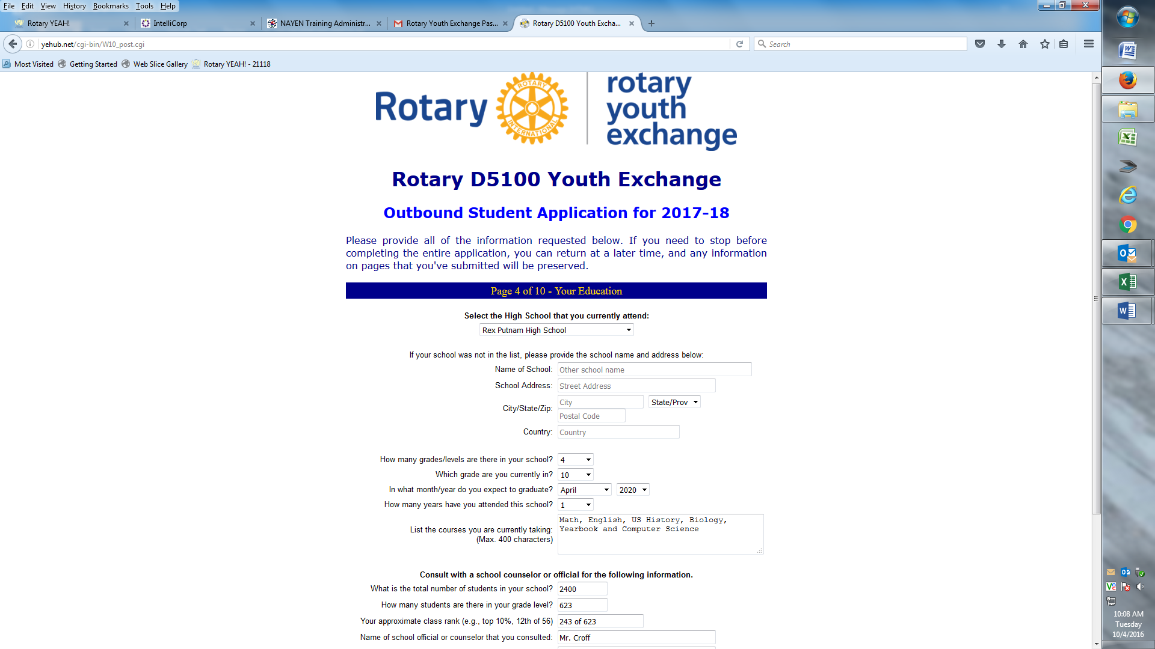
Page 4 - Top

Slide 14
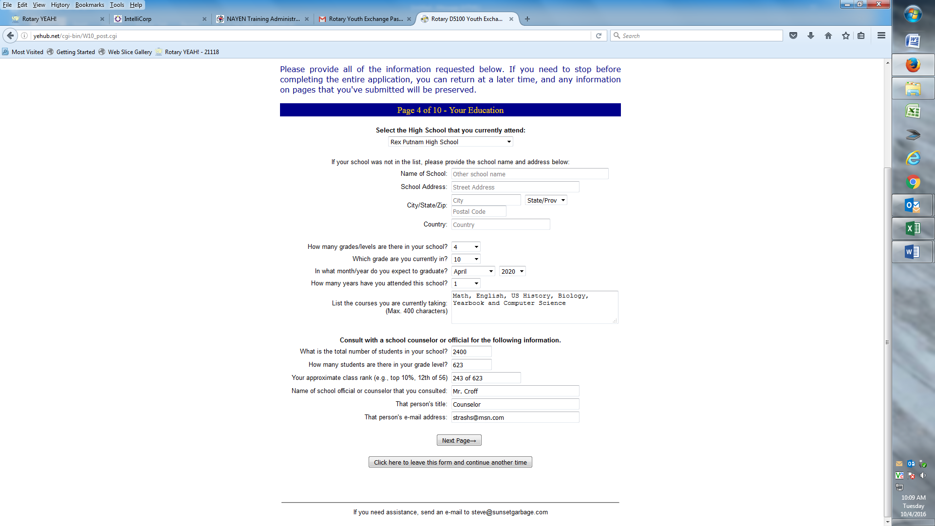
Page 4 - Bottom

Slide 15
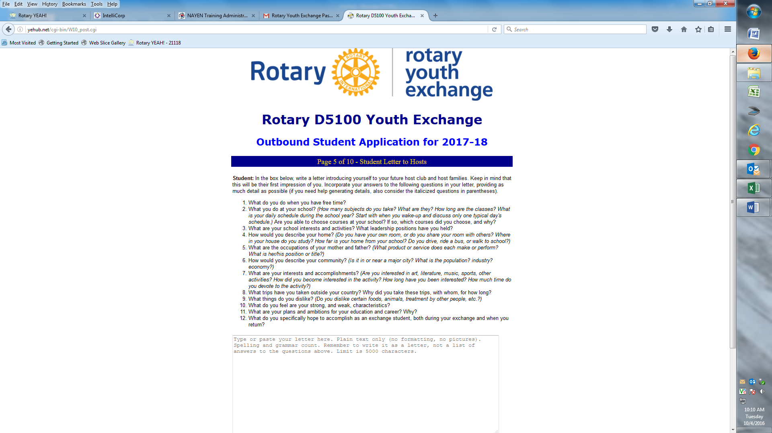
Page 5 - Letter

Slide 16
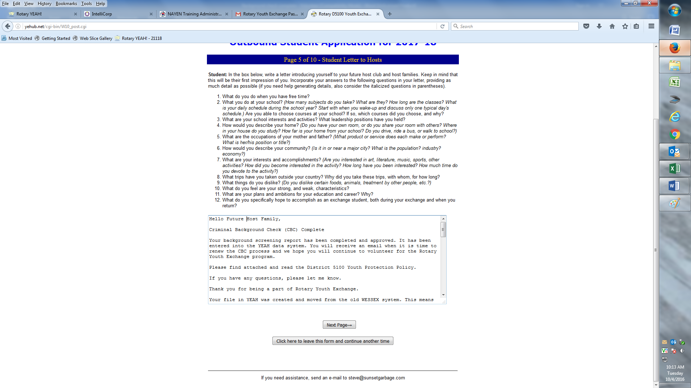
Letter inserted – 5000 characters - max

Slide 17
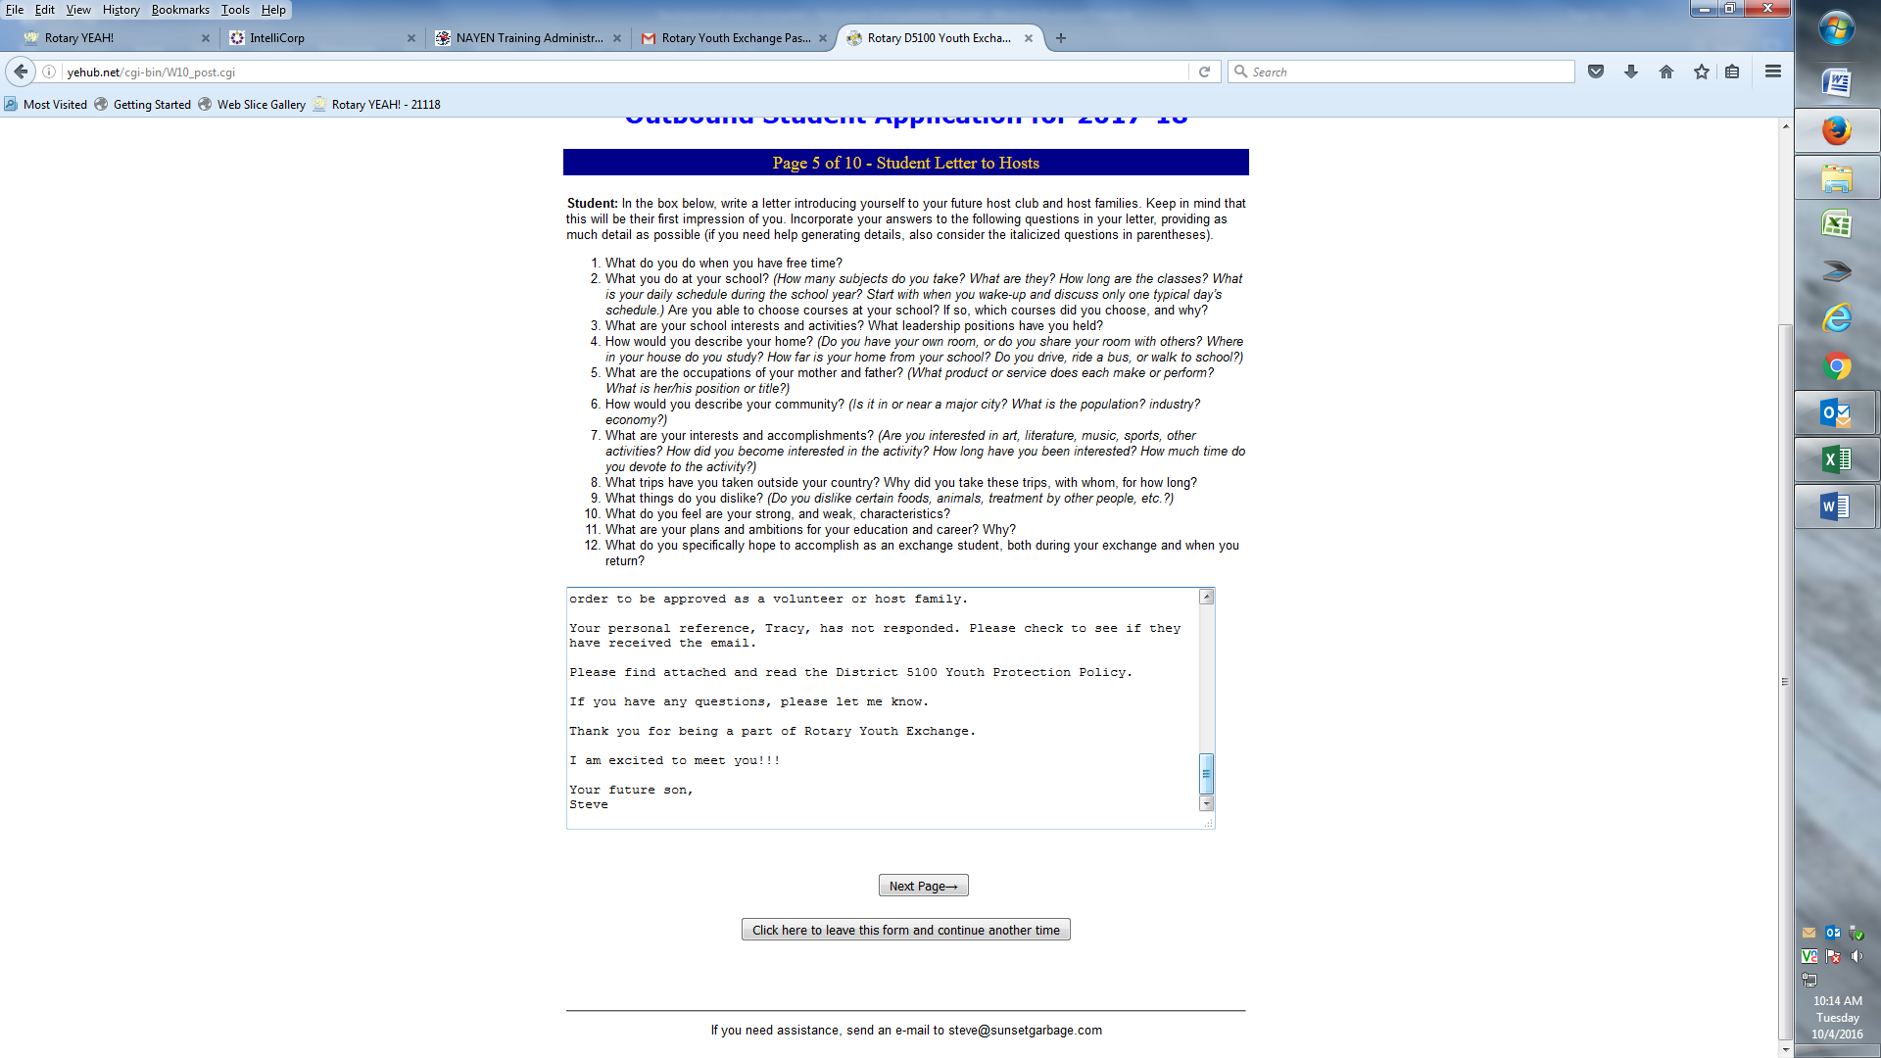
Letter inserted and signed SCROLL to the BOTTOM to make sure it fits

Slide 18
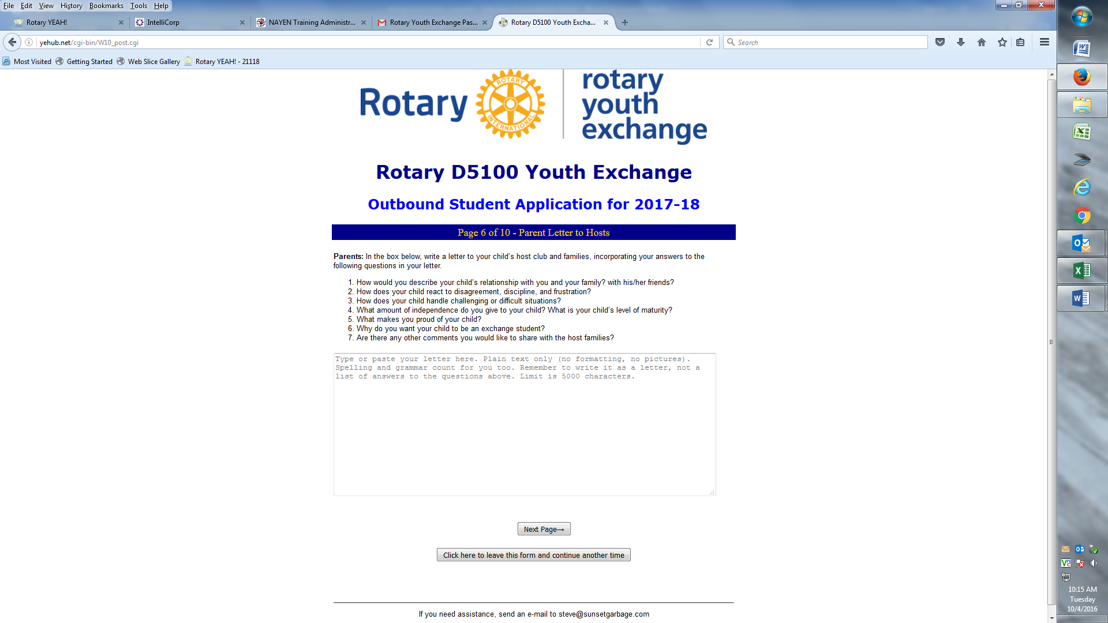
Page 6 - Parent letter

Slide 19
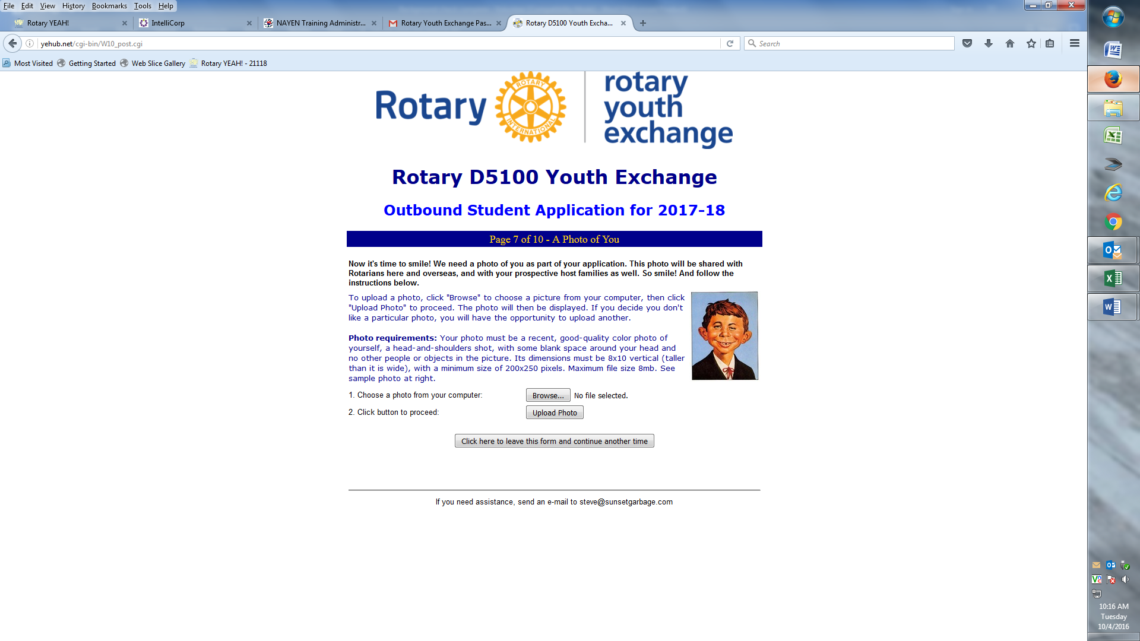
Page 7 – Picture page

Slide 20
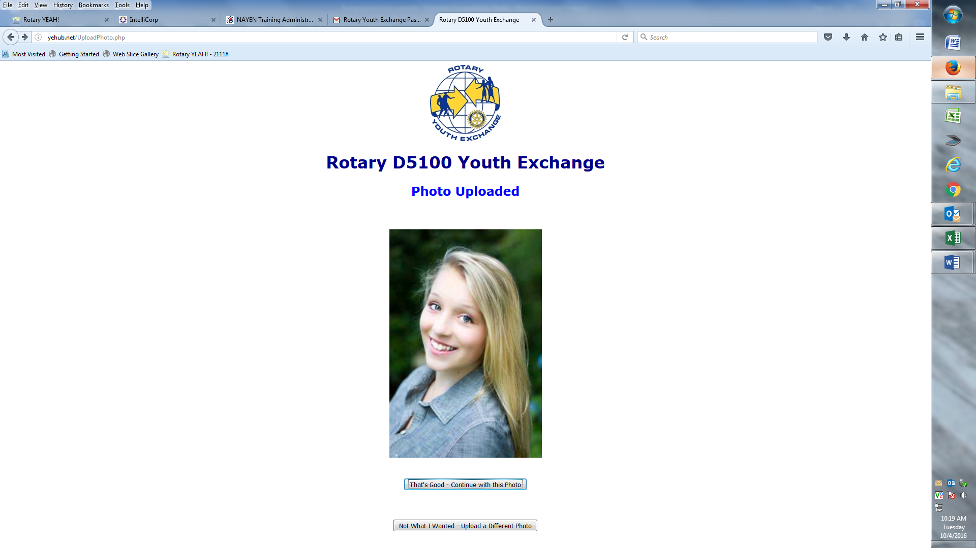
Page 7 – Picture added

Slide 21
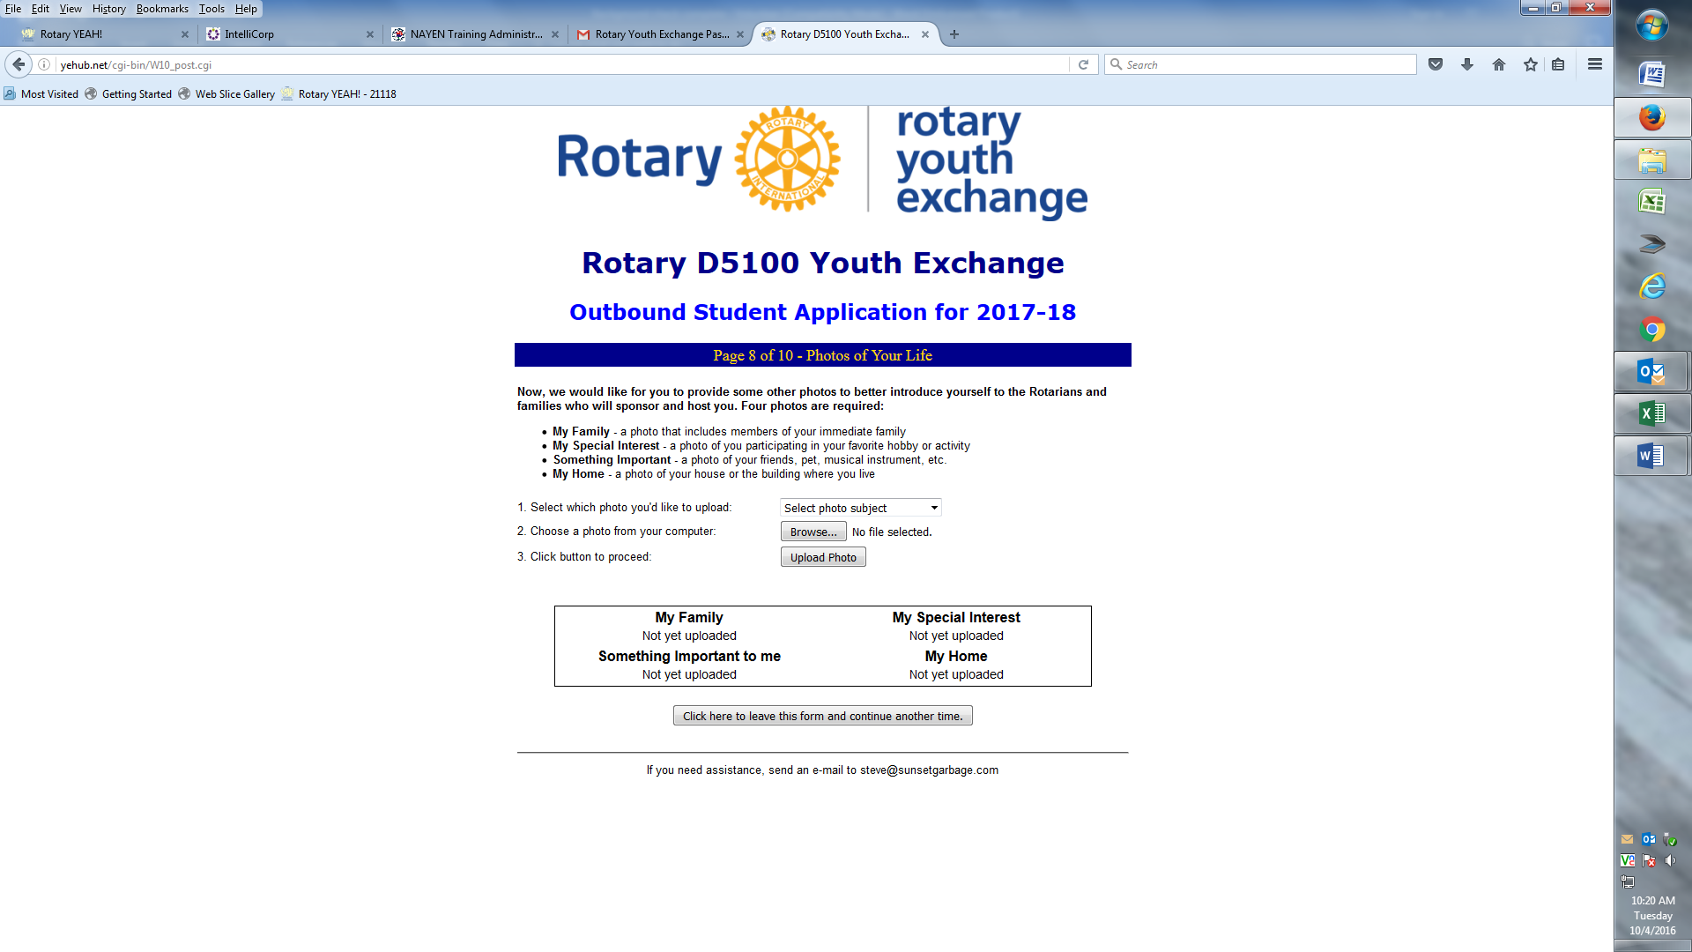
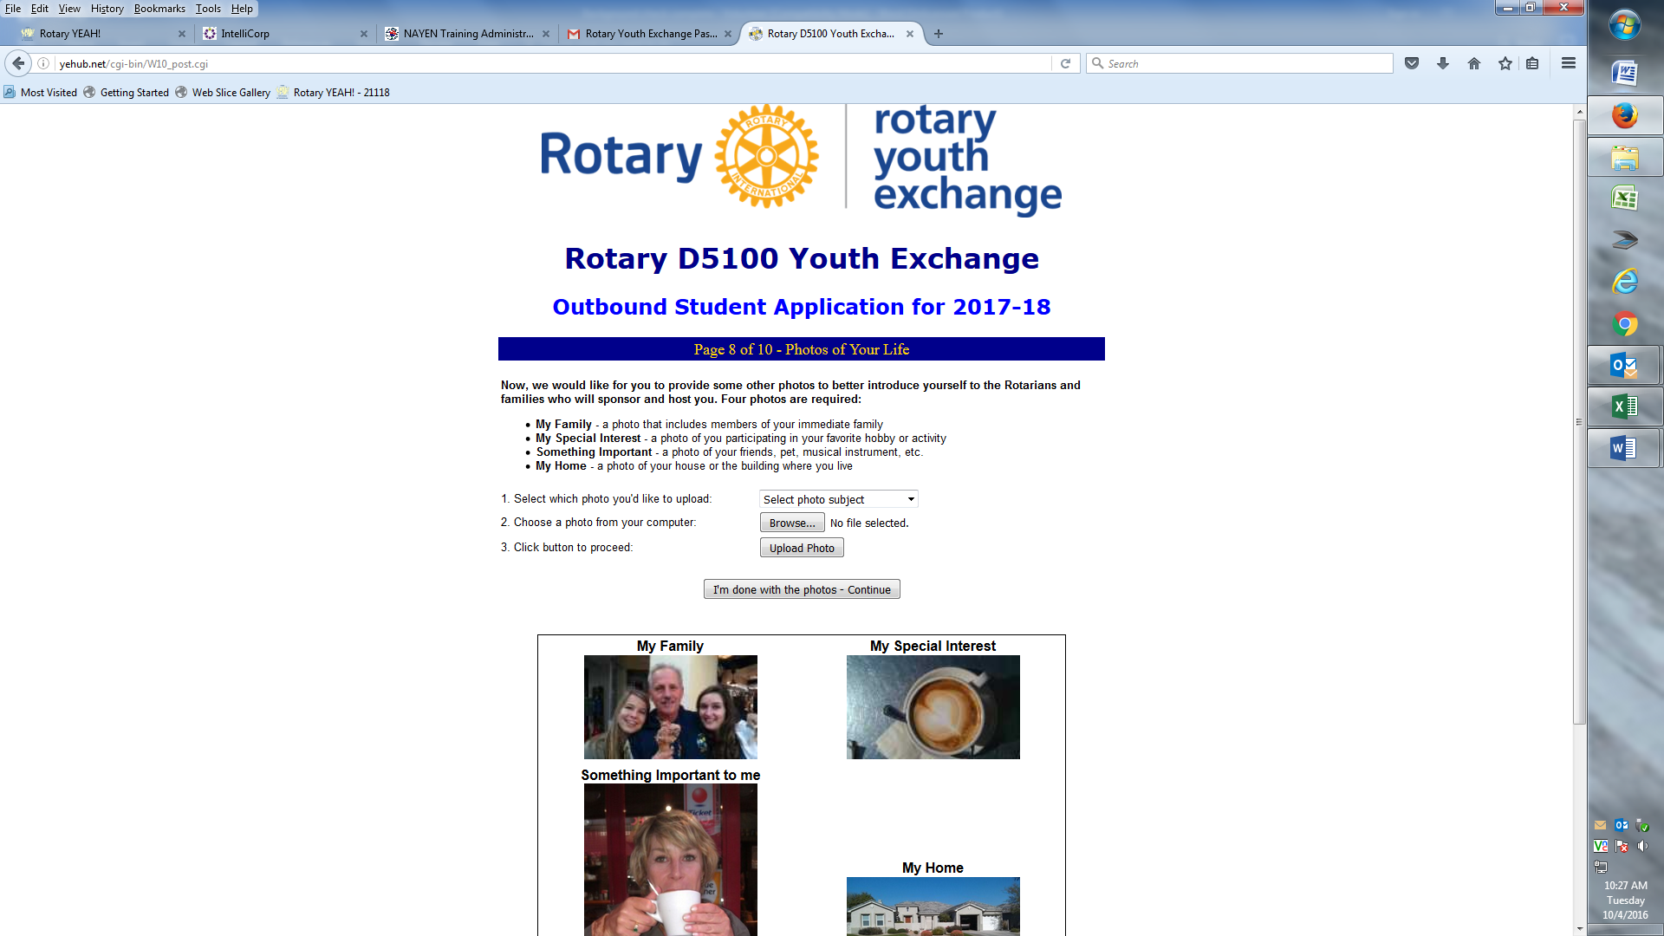
Page 8 - Pictures

Slide 22
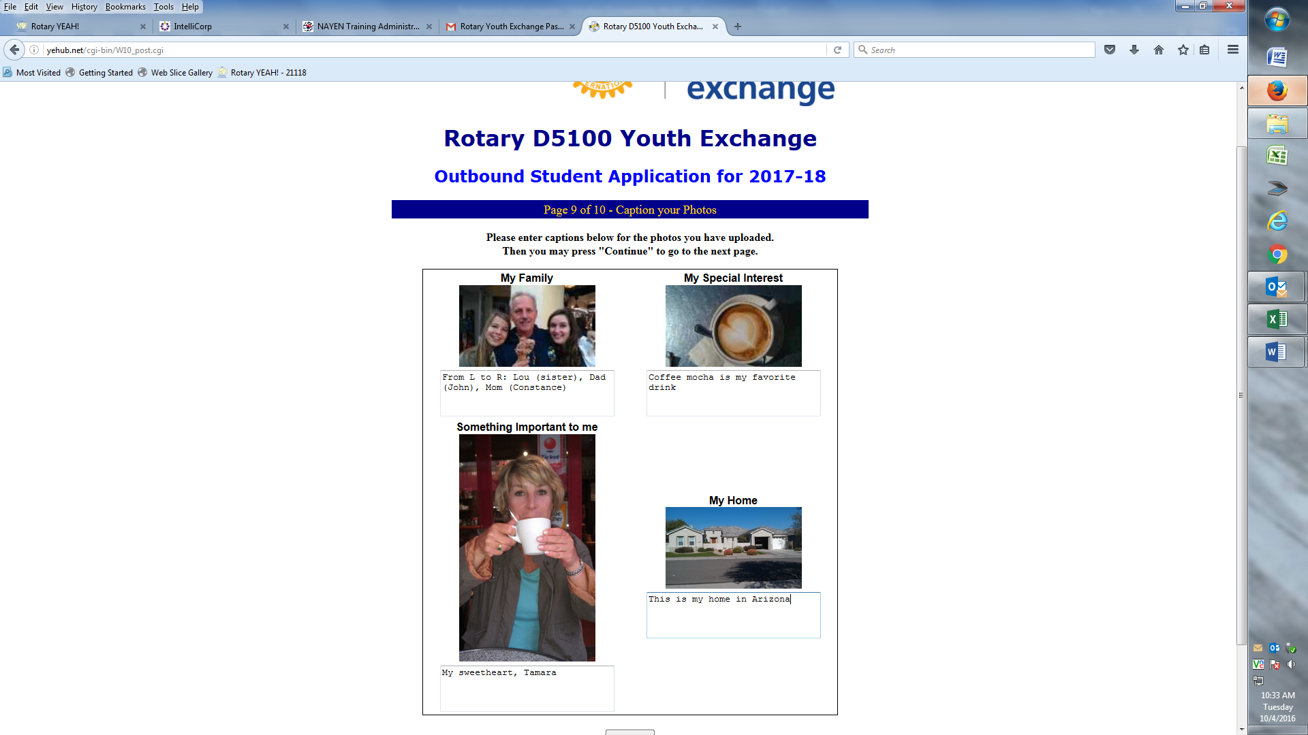
Pictures with captions

Slide 23
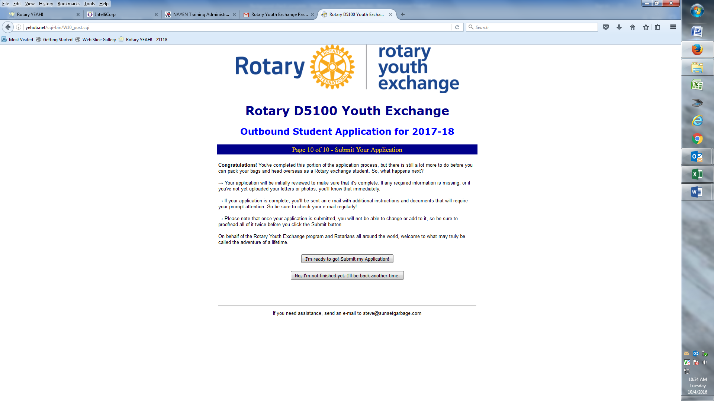
Page 10 – Submit page

Slide 24
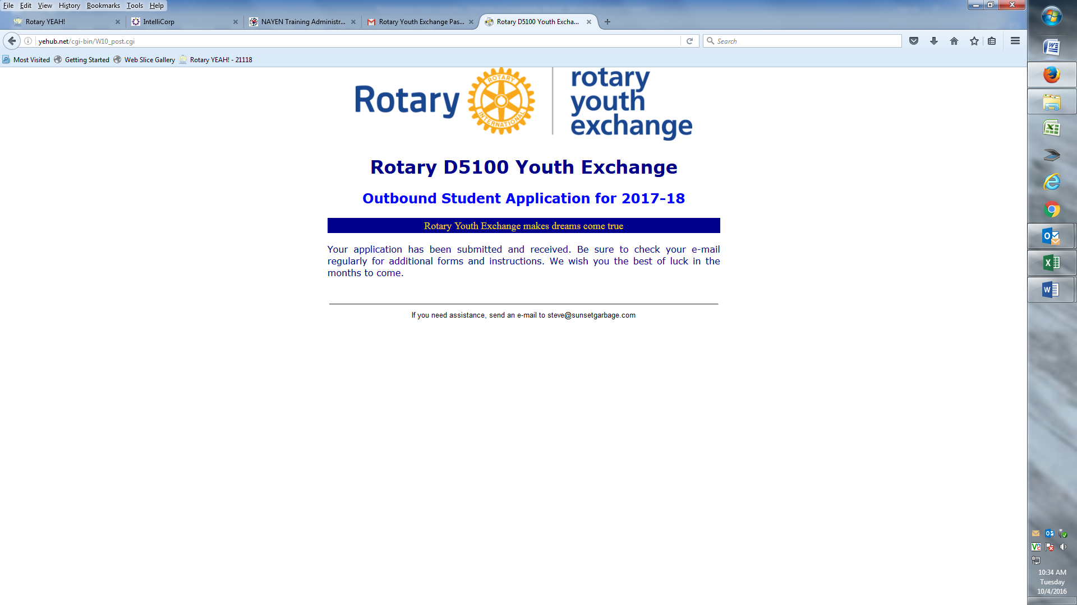
Part 1 – Complete – Can be updated later

Slide 25
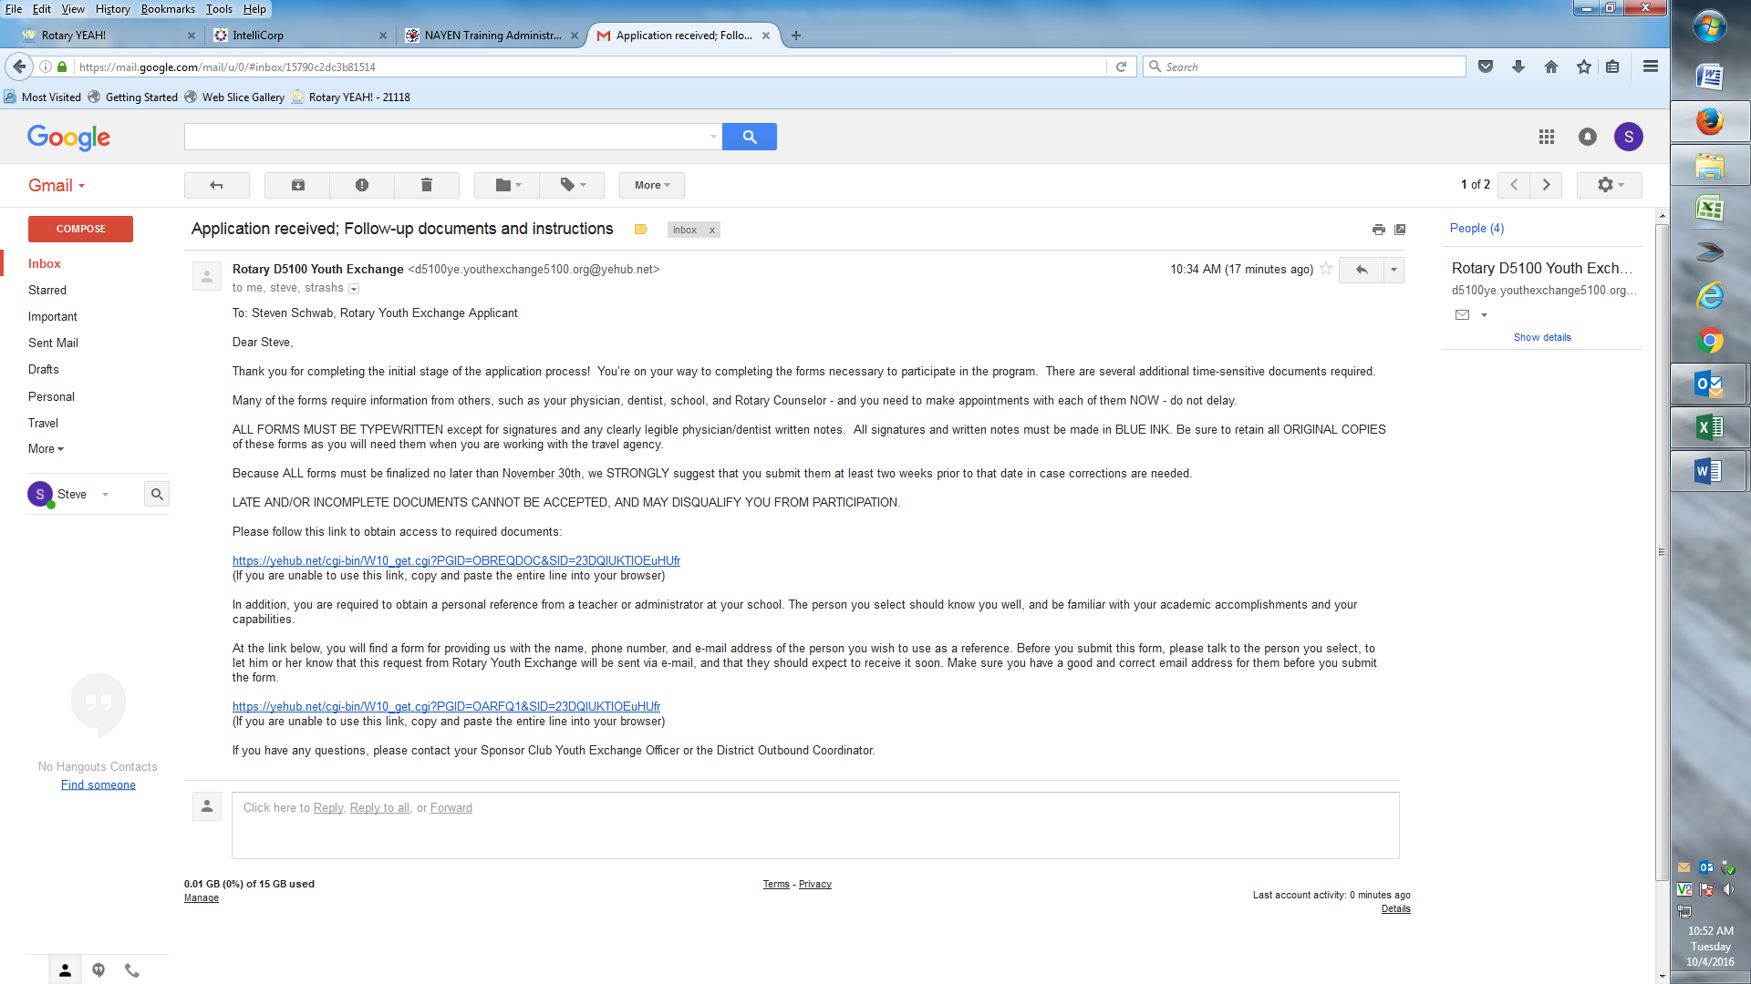
Email that you receive after you submit Part 1 of the application. It has links - one to the required forms and one to the school reference.

Slide 26
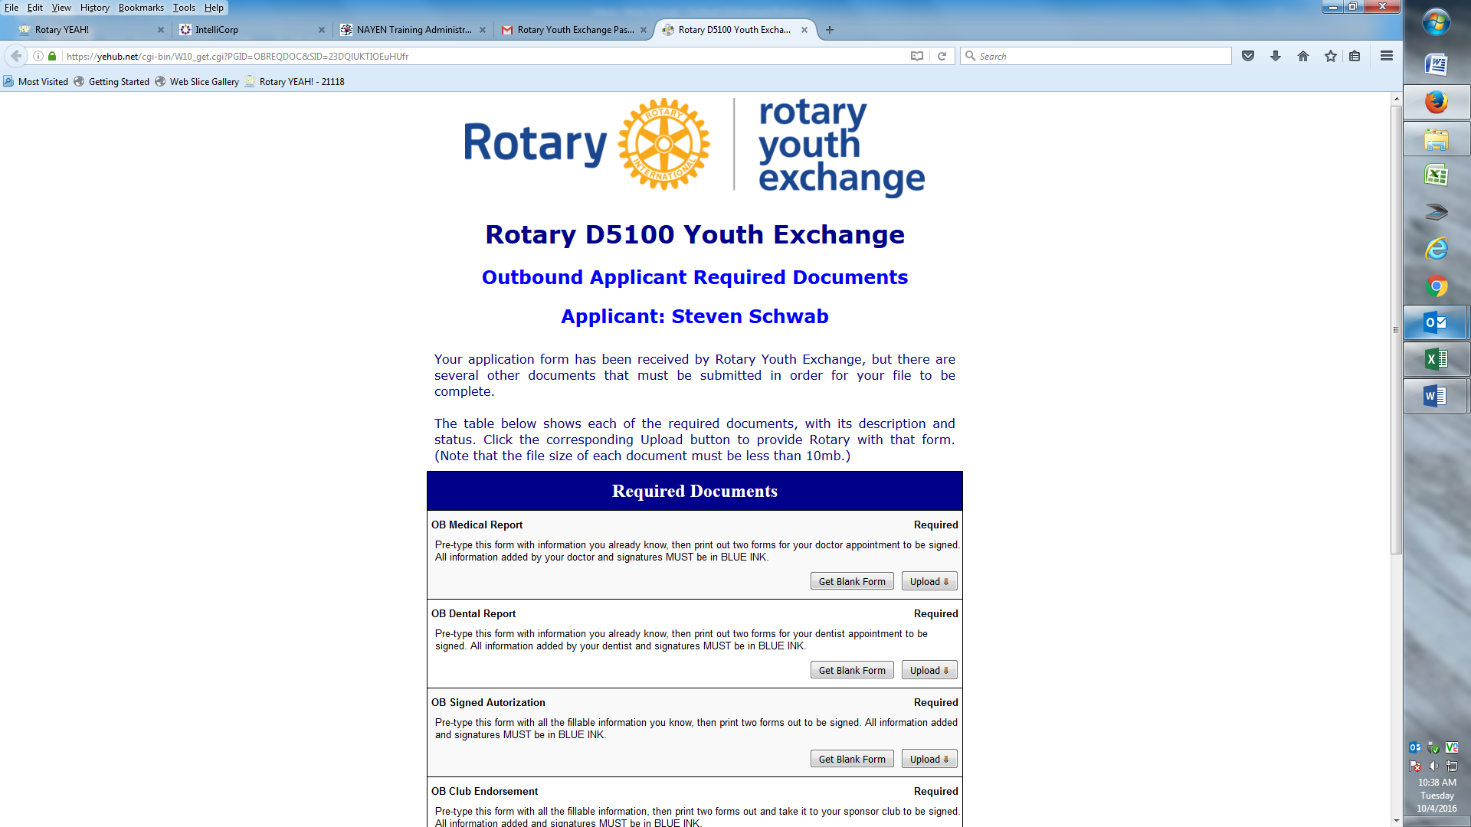
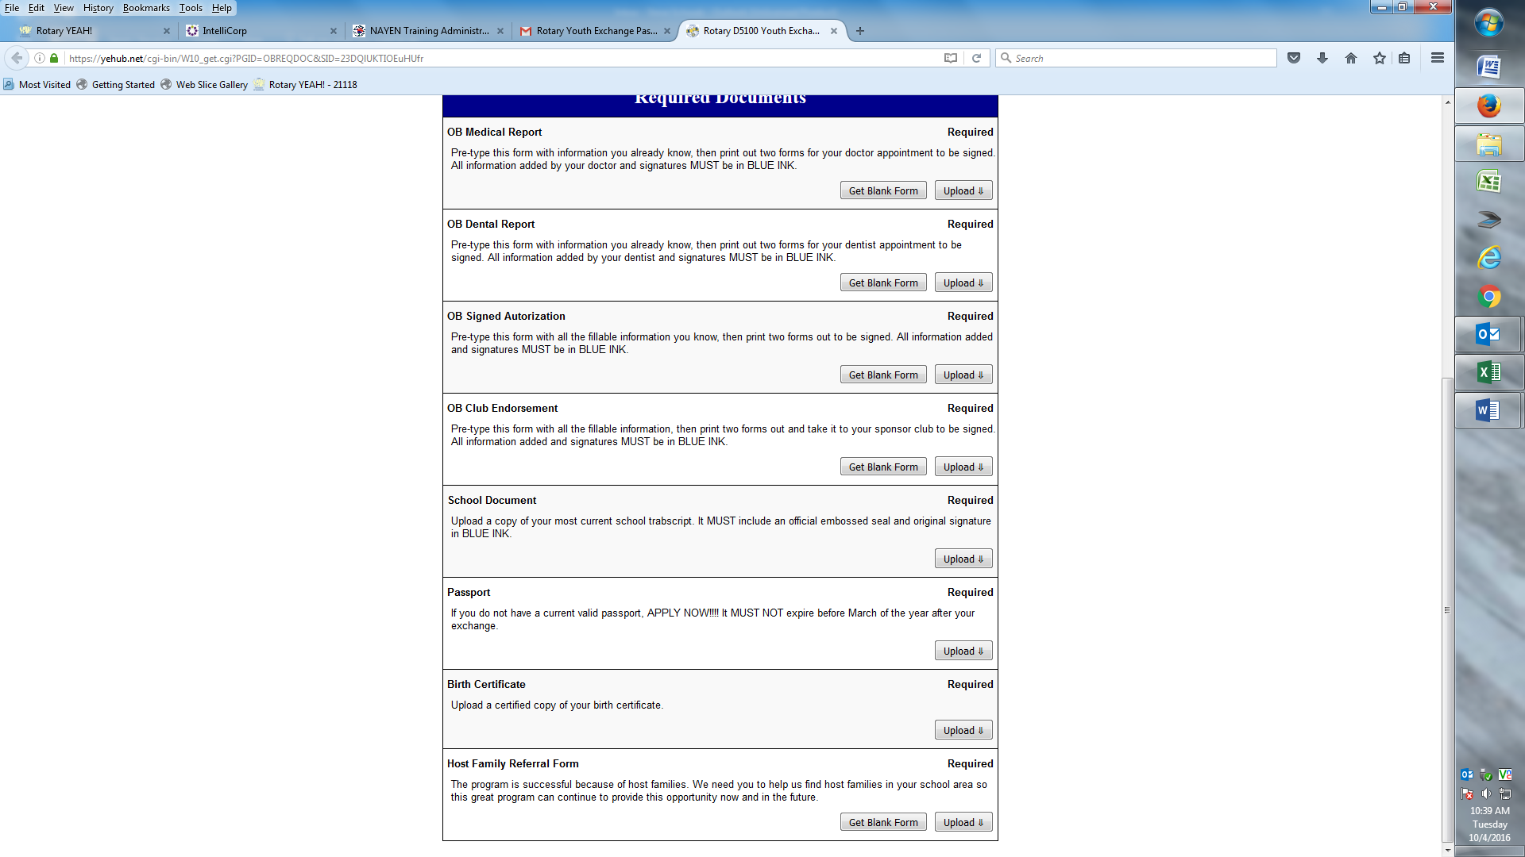
First link takes you to this page – Required Documents

Slide 27
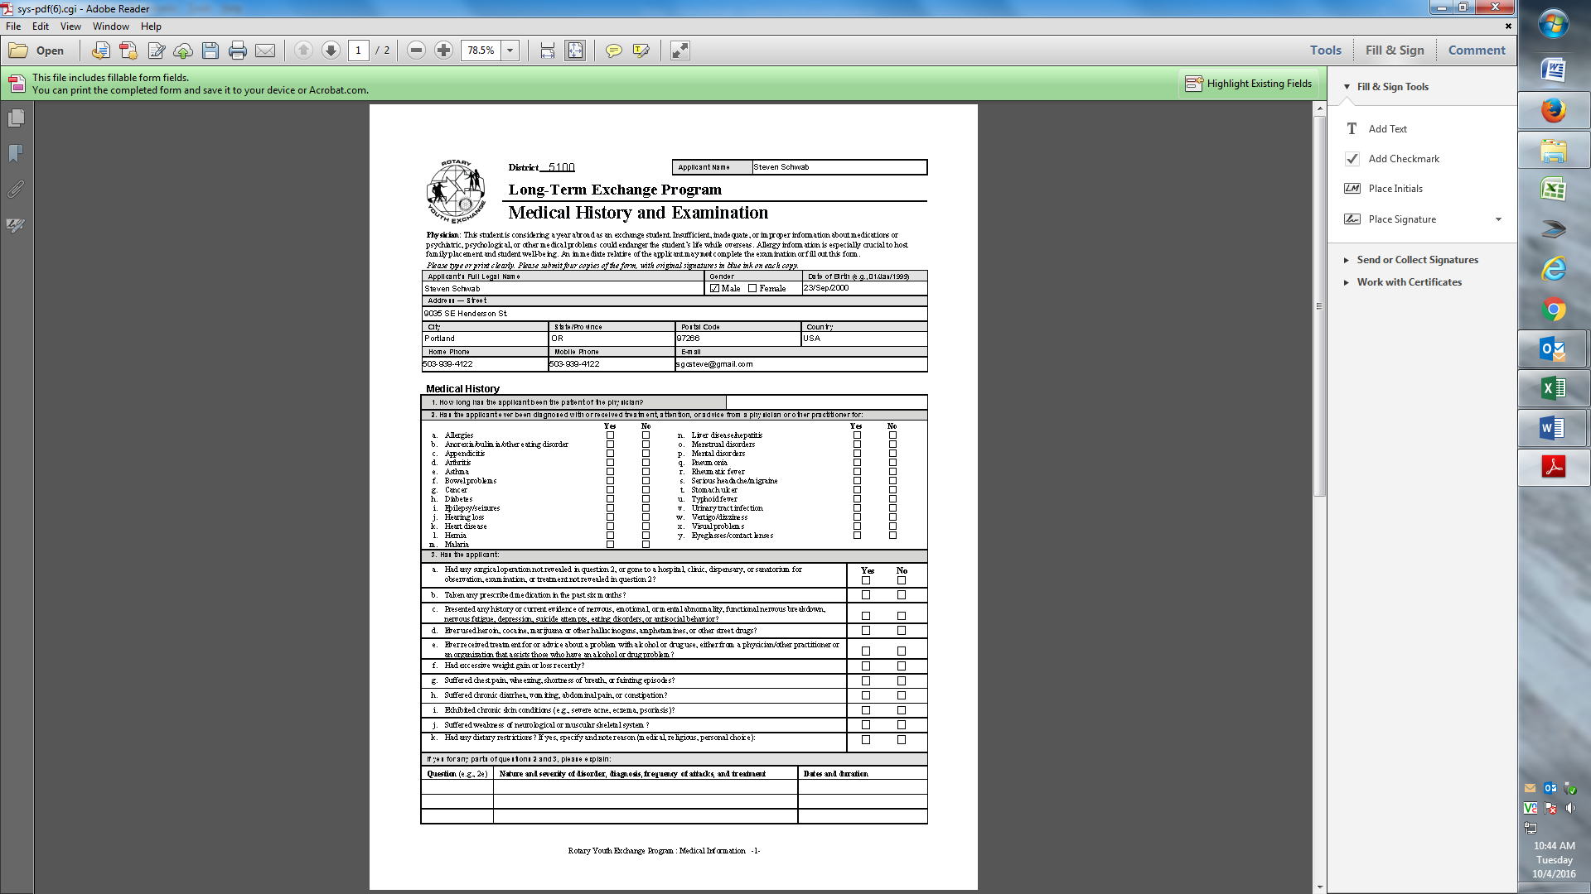
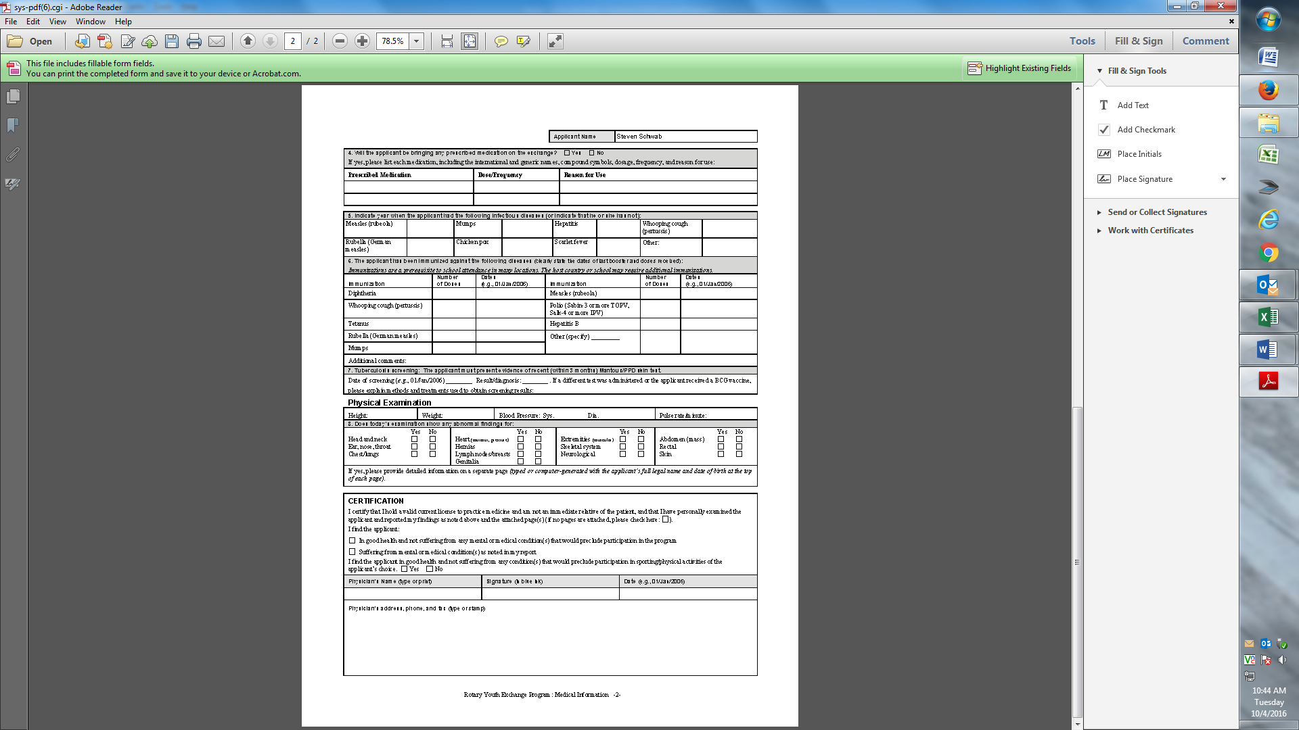
Medical form - BLUE INK

Slide 28
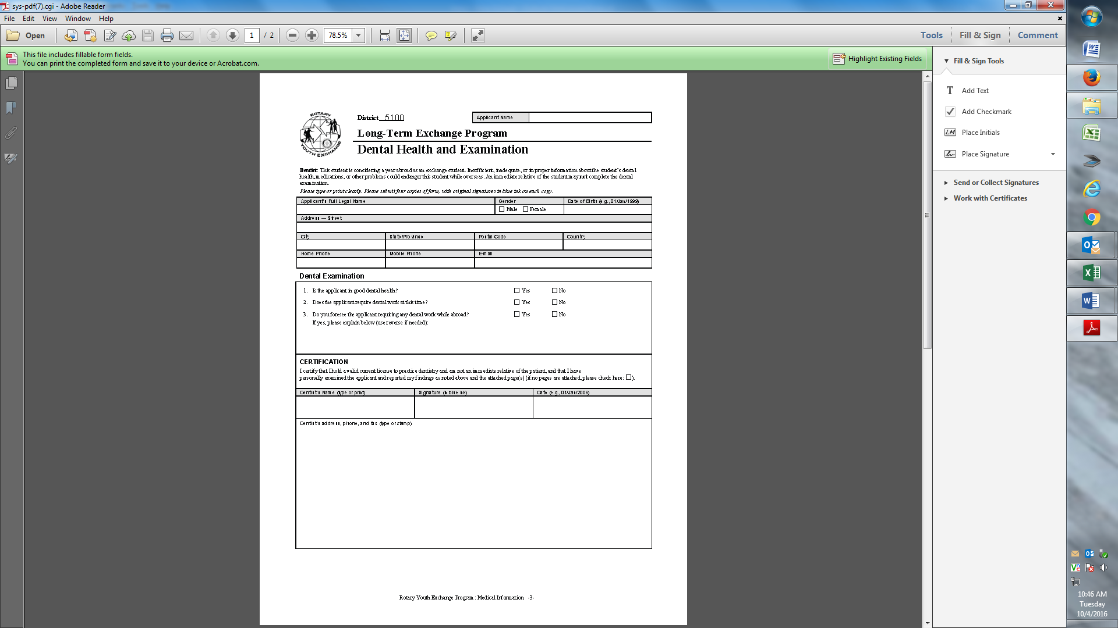
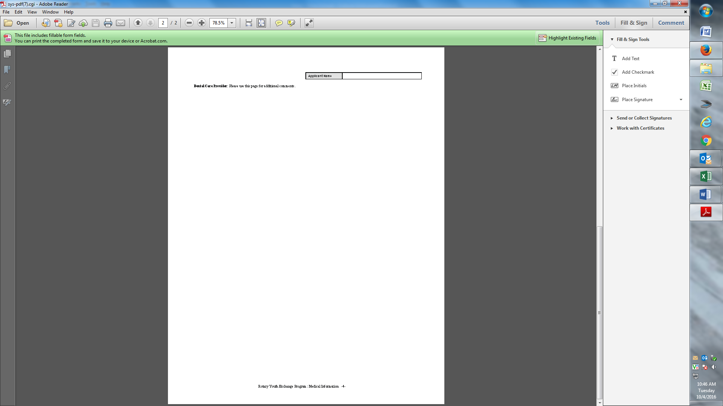
Dental Form – BLUE INK

Slide 29
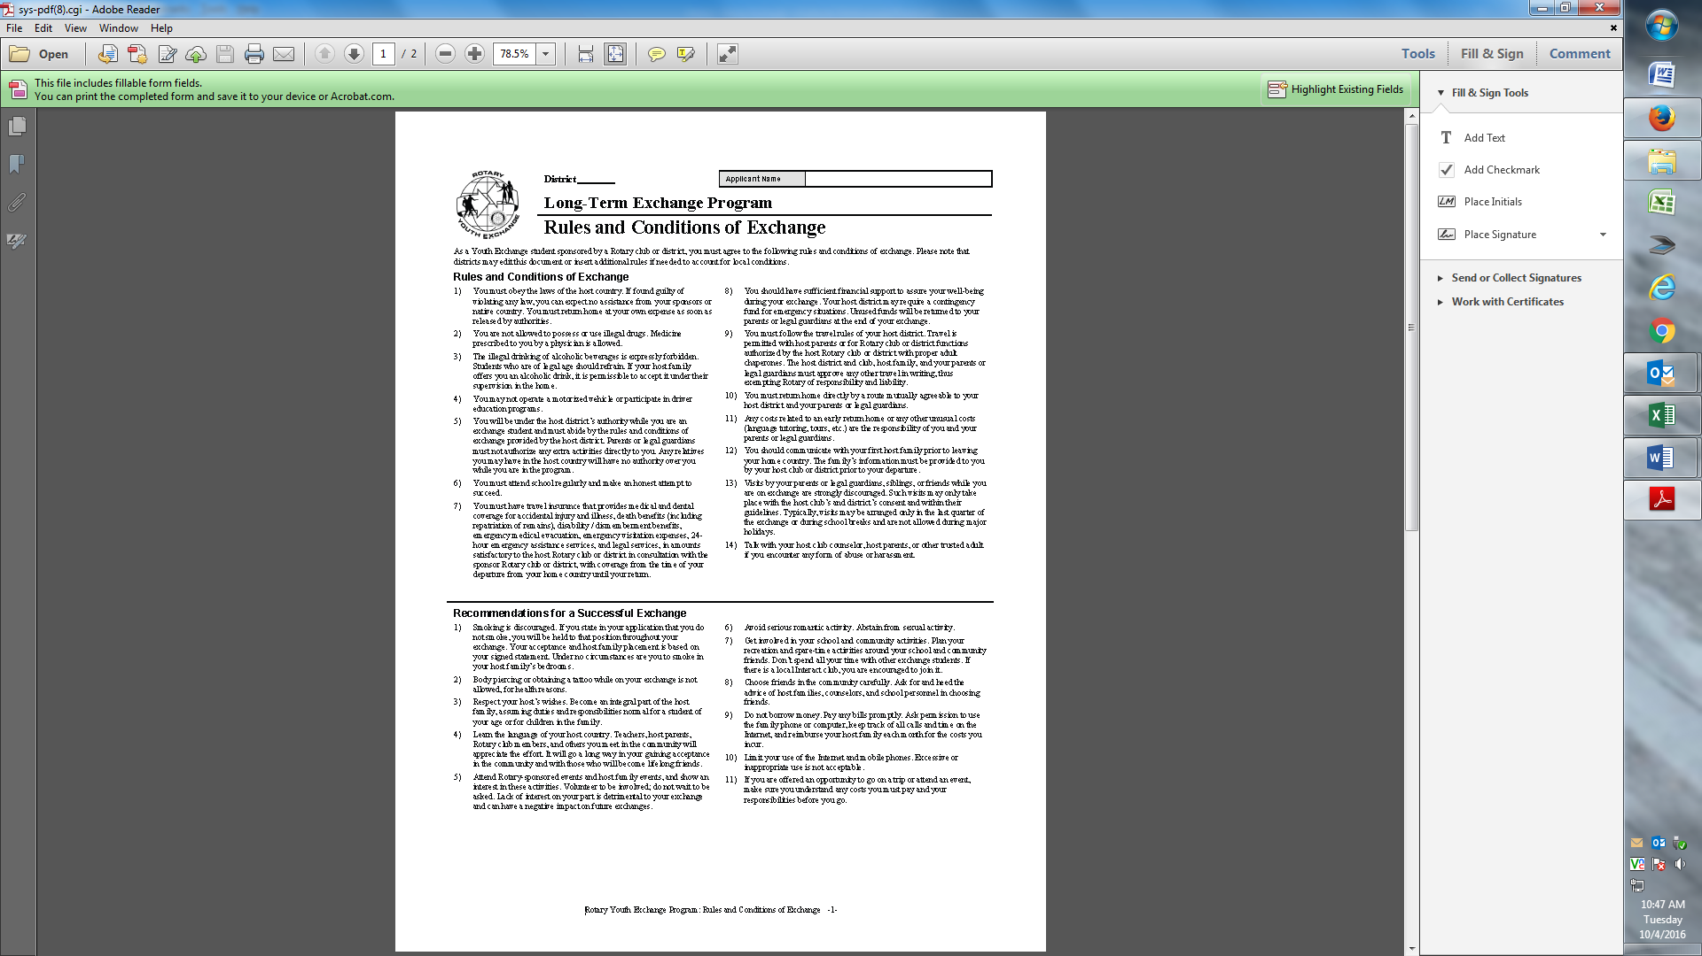
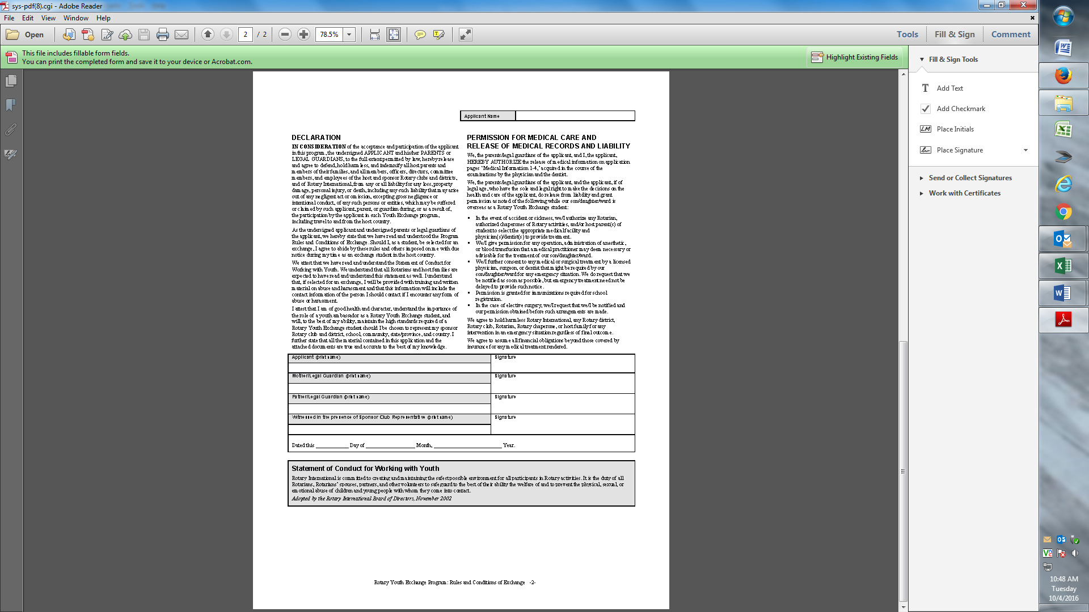
Rules/Release Page – BLUE INK

Slide 30
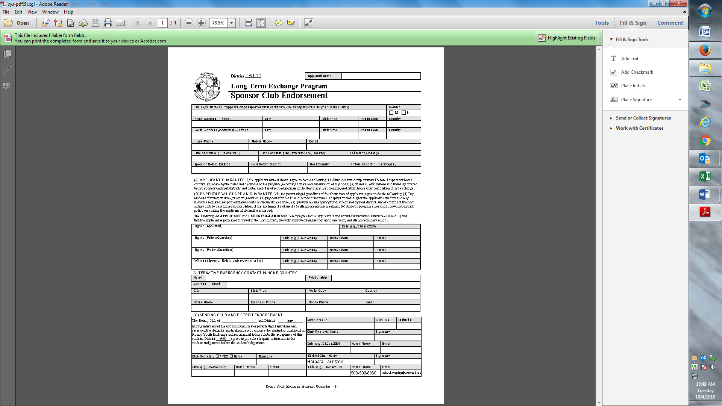
Club Endorsement Form – Guarantee Get all the information first – make two copies BLUE INK for all signatures

Slide 31
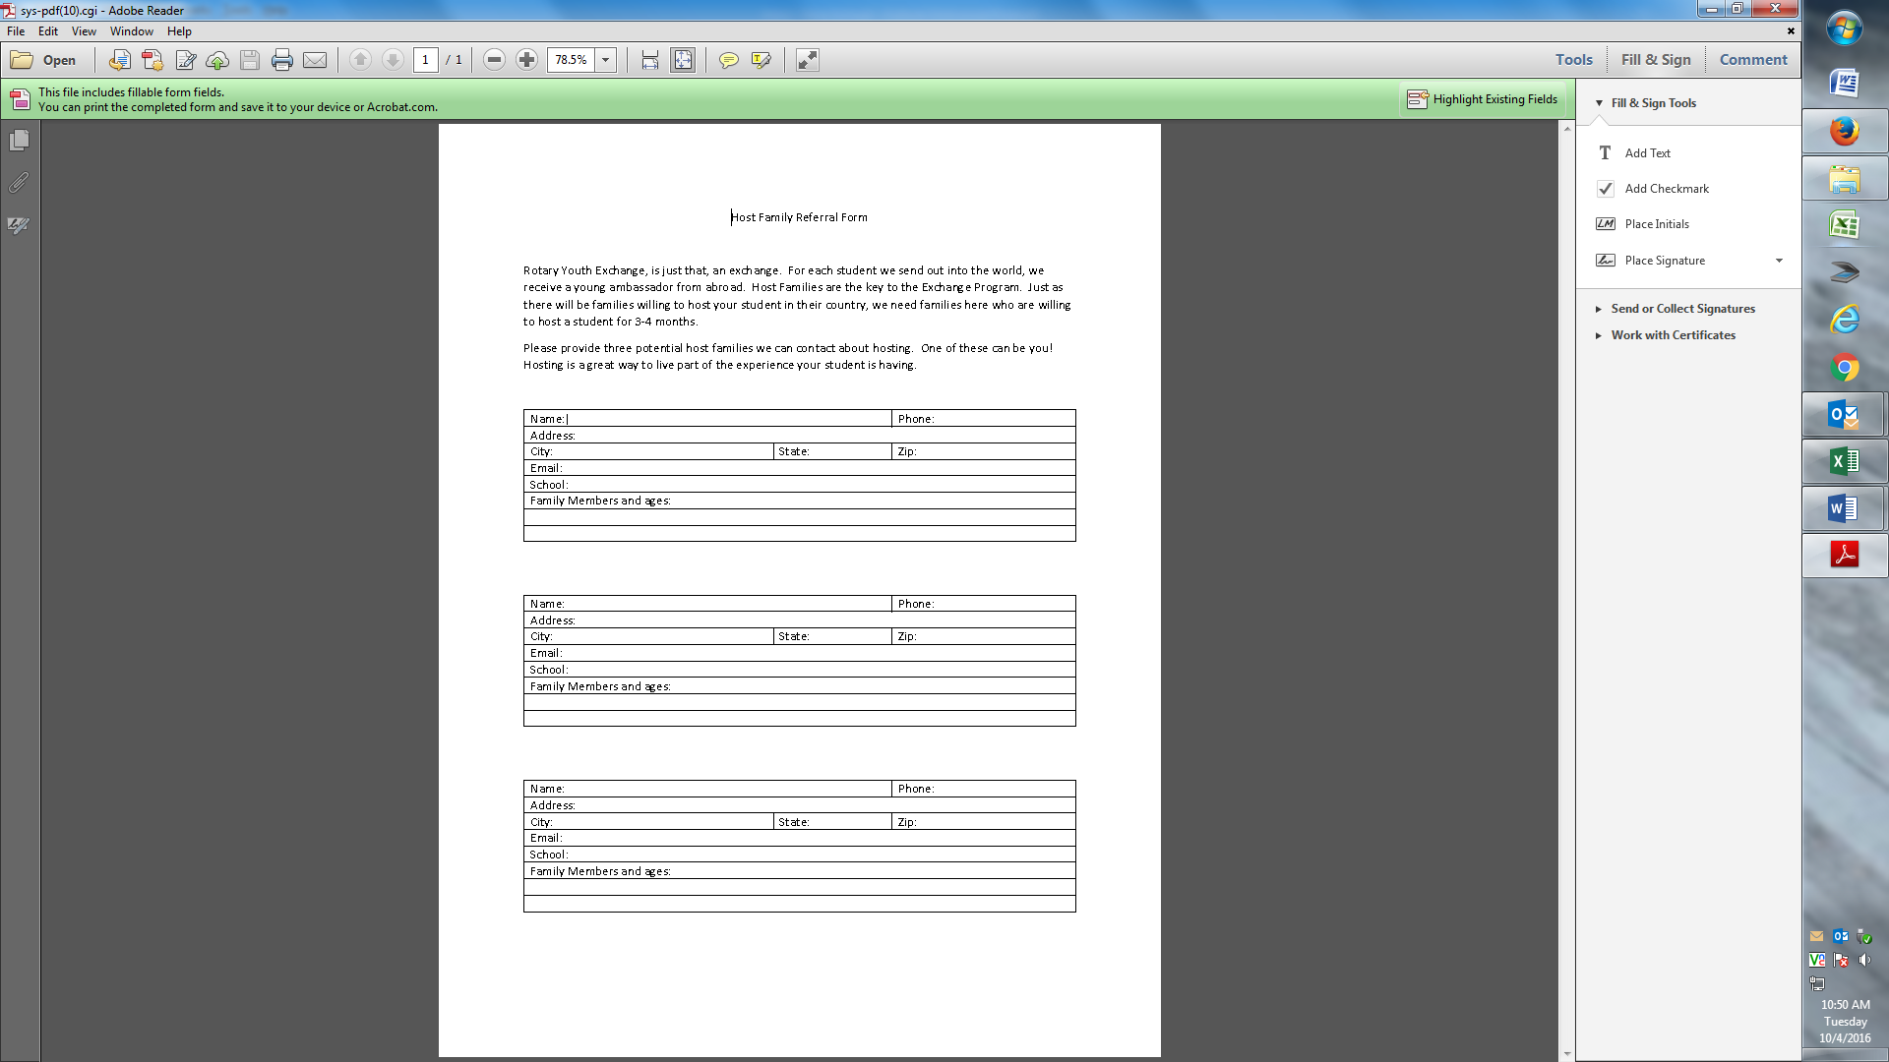
Host Family Referral form – Clubs need this help – Upload and Give a copy to your sponsor club.

Slide 32
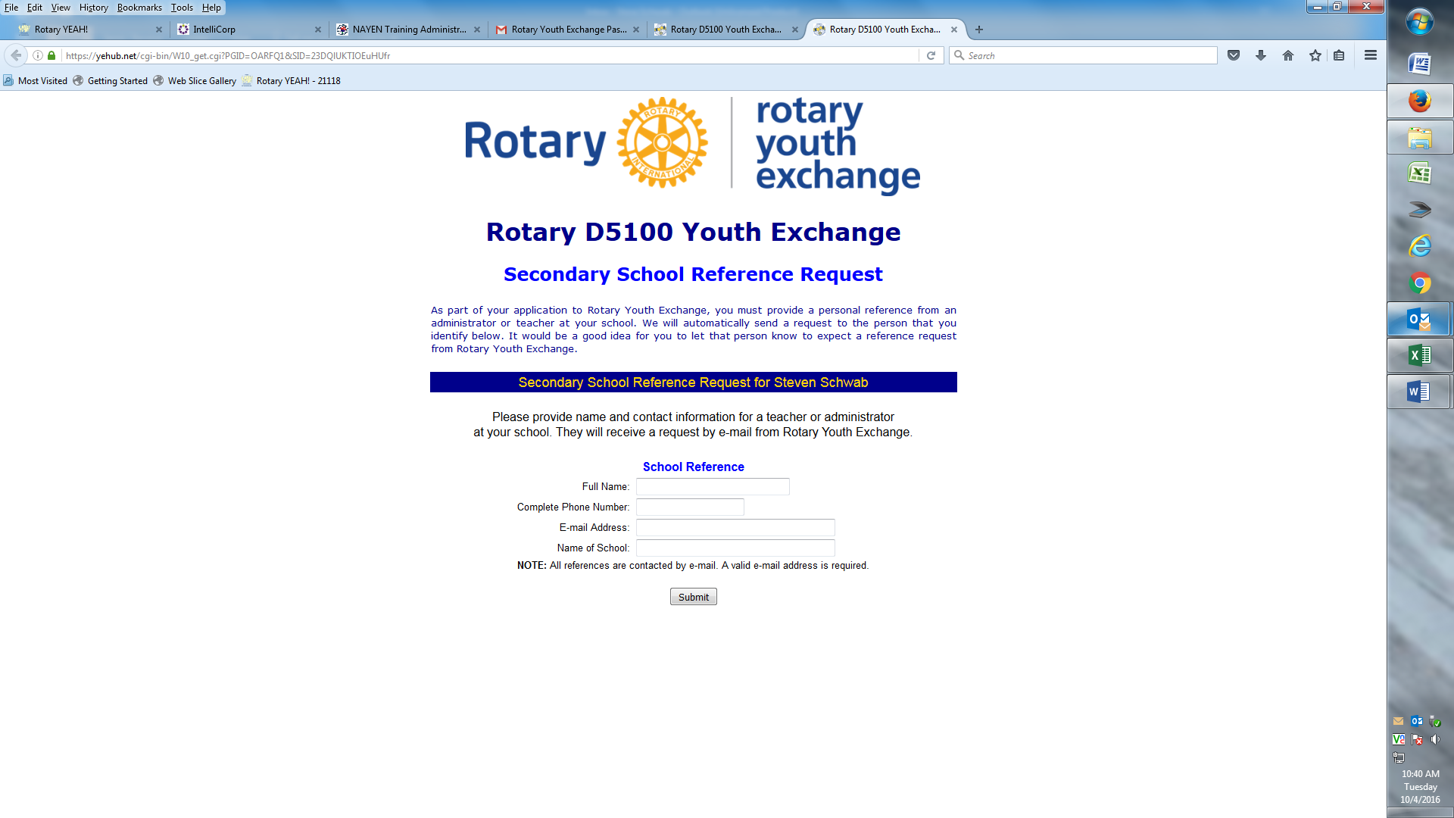
School Reference Link – Get person’s information first – Name, Phone Number, Email Address and School. You can have more than one reference, just do this process again.

